Slide 1
Non-parametric Tests
Prof. Andy Field

Slide 2
Aims
When and why we use non-parametric tests?
Mann-Whitney test
Wilcoxon rank-sum test
Wilcoxon signed-rank test
Kruskal–Wallis test
Jonckheere–Terpstra test
Friedman’s ANOVA
Ranking data
Interpretation of results
Reporting results
Calculating an Effect Size

Slide 3
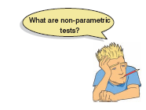
When to use nonparametric tests
Non-parametric tests are used when assumptions of parametric tests are not met.
It is not always possible to correct for problems with the distribution of a data set
In these cases we have to use non-parametric tests.
They make fewer assumptions about the type of data on which they can be used.
In general, you are better off trying to use a robust test but the range of robust tests is limited in SPSS.

Slide 4
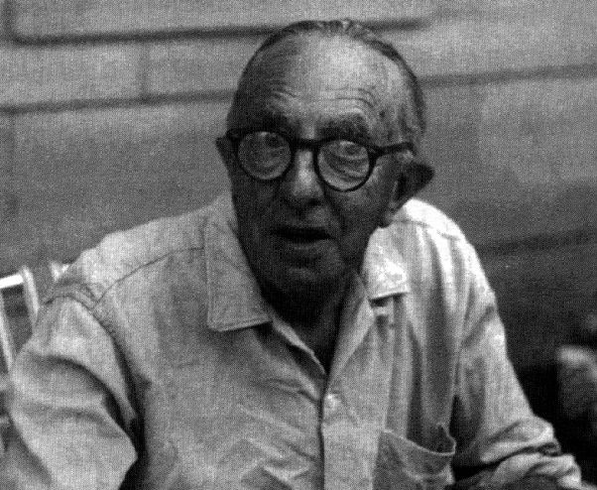
The Wilcoxon rank-sum test and Mann–Whitney test
These tests are the non-parametric equivalent of the independent t-test.
Use either to test differences between two conditions in which different participants have been used.

Slide 5

Ranking Data
The tests in this lecture work on the principle of ranking the data for each group:
Lowest score = a rank of 1,
Next highest score = a rank of 2, and so on.
Tied ranks are given the same rank: the average of the potential ranks.
For an unequal group size
The test statistic (Ws) = sum of ranks in the group that contains the least people.
For an equal group size
Ws = the value of the smaller summed rank.
Add up the ranks for the two groups and take the lowest of these sums to be our test statistic.
The analysis is carried out on the ranks rather than the actual data.

Slide 6
Theory
A neurologist investigated the depressant effects of certain recreational drugs.
Tested 20 clubbers
10 were given an ecstasy tablet to take on a Saturday night
10 were allowed to drink only alcohol.
Levels of depression were measured using the Beck Depression Inventory (BDI) the day after and midweek.
Rank the data ignoring the group to which a person belonged
A similar number of high and low ranks in each group suggests depression levels do not differ between the groups.
A greater number of high ranks in the ecstasy group than the alcohol group suggests the ecstasy group is more depressed than the alcohol group.

Slide 7
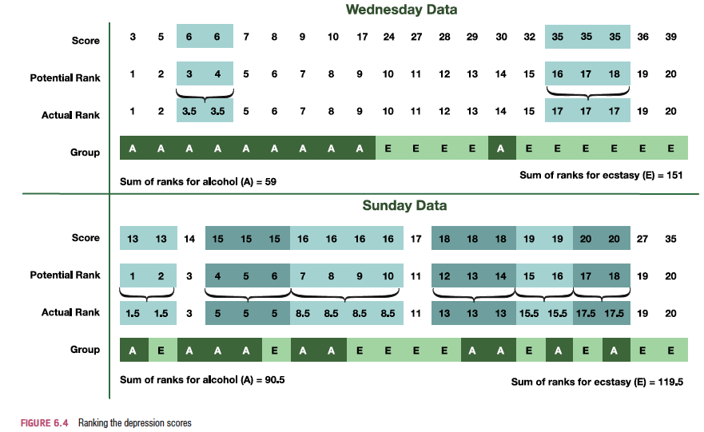
Ranking the Depression scores for Wednesday and Sunday

Slide 8
Provisional analysis using IBM SPSS
First enter the data into SPSS
Because the data are collected using different participants in each group, we need to input the data using a coding variable.
For example, ‘Drug’ with the codes; 1 = ecstasy group and 2 = alcohol group.
When you enter the data into SPSS remember to tell the computer that a code of 1 represents the group that was given ecstasy and a code of 2 represents the group that was restricted to alcohol.
First, run some exploratory analyses on the data
Run these exploratory analyses for each group because we’re going to be looking for group differences.

Slide 9
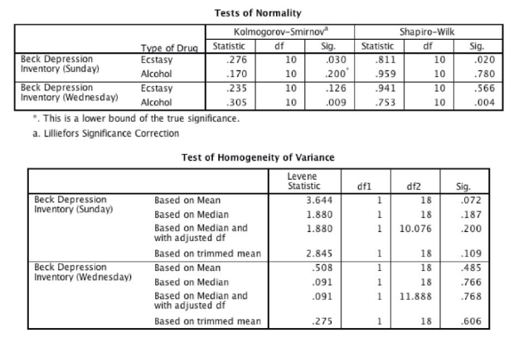
Exploratory Analysis Output

Slide 10
Interpreting Output
Testing for normality
Sunday data:
Ecstasy, D(10) = 0.28, p = .03 (non normal)
Alcohol, D(10) = 0.17, p = .20 (normal)
Wednesday data:
Ecstasy, D(10) = 0.24, p = .13 (normal)
Alcohol, D(10) = 0.31, p = .01 (non normal)
A non-parametric test should be used.
Results of Levene’s test
The assumption of homogeneity has been met:
Sunday data, F(1, 18) = 3.64, p = .07.
Wednesday, F(1, 18) = 0.51, p = .49.

Slide 11
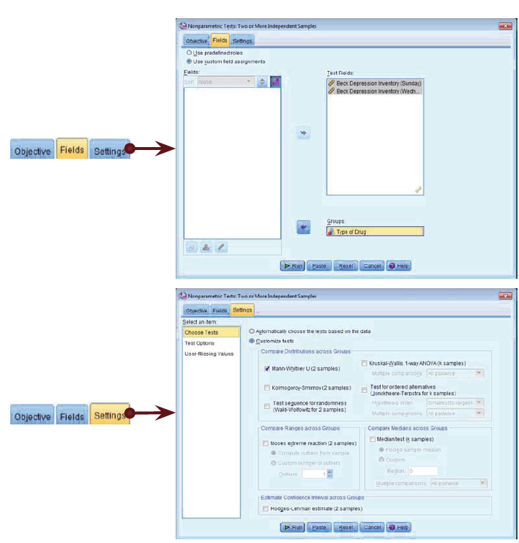
Running the Analysis

Slide 12
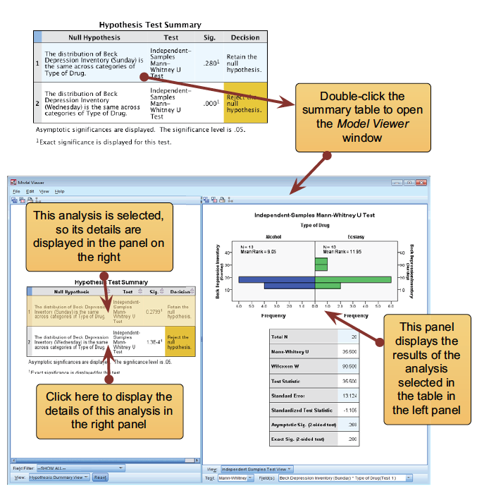

Slide 13
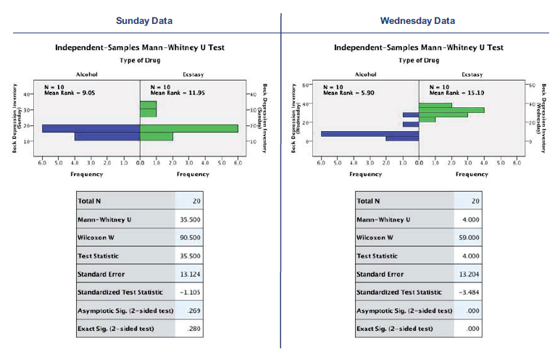

Slide 14
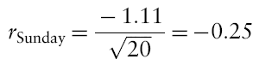
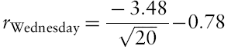
Calculating an Effect Size
The equation to convert a z-score into the effect size estimate, r, is as follows (from Rosenthal, 1991: 19):
z is the z-score that SPSS produces
N is the size of the study (i.e. the number of total observations)
We had 10 ecstasy users and 10 alcohol users and so the total number of observations was 20.

Slide 15
Reporting the Results
For the Mann–Whitney test:
Depression levels in ecstasy users (Mdn = 17.50) did not differ significantly from alcohol users (Mdn = 16.00) the day after the drugs were taken, U = 35.50, z = −1.11, p = .280, r = −.25. However, by Wednesday, ecstasy users (Mdn = 33.50) were significantly more depressed than alcohol users (Mdn = 7.50), U = 4.00, z = −3.48, p < .001, r = −.78.

Slide 16
Reporting the Results II
Or we could report Wilcoxon’s test:
Depression levels in ecstasy users (Mdn = 17.50) did not significantly differ from alcohol users (Mdn = 16.00) the day after the drugs were taken, Ws = 90.50, z = −1.11, p = .280, r = −.25. However, by Wednesday, ecstasy users (Mdn = 33.50) were significantly more depressed than alcohol users (Mdn = 7.50), Ws = 59.00, z = −3.48, p < .001, r = −.78.

Slide 17
Comparing two related conditions: the Wilcoxon signed-rank test
Uses:
To compare two sets of scores, when these scores come from the same participants.
Imagine the experimenter was interested in the change in depression levels for each drug.
Non-parametric test because the distributions of scores for both drugs were non-normal on one of the days.

Slide 18
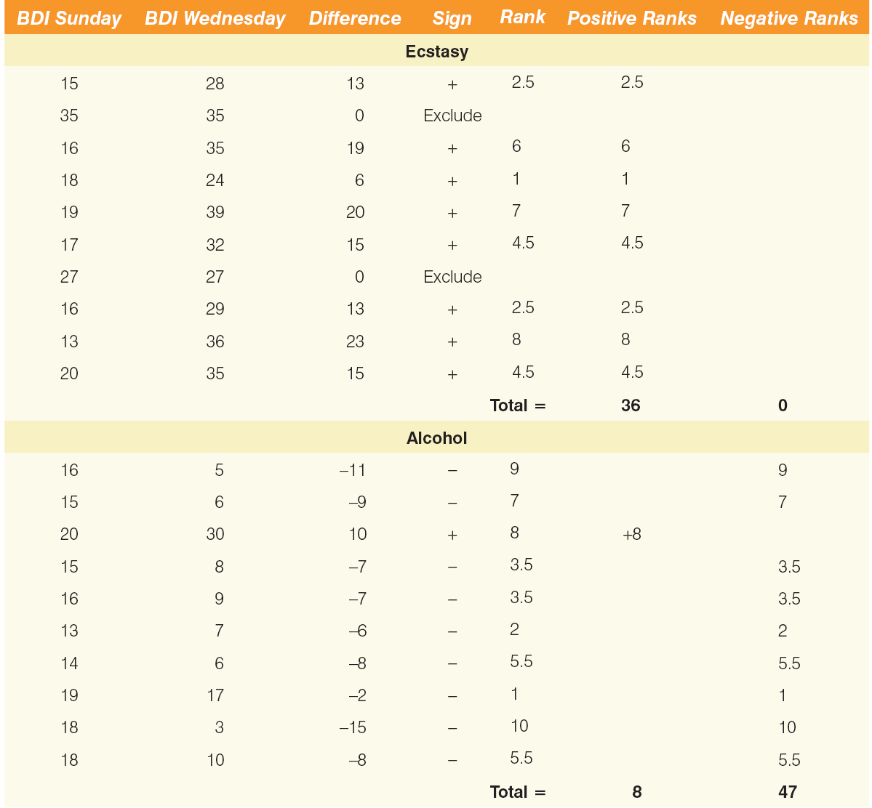
Ranking data in the Wilcoxon signed-rank test

Slide 19
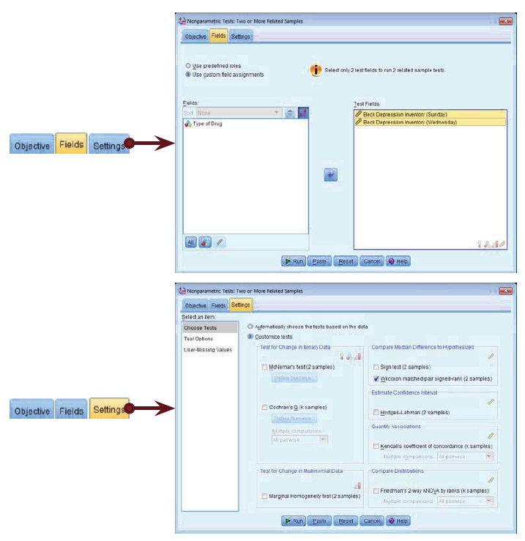
Running the Analysis

Slide 20
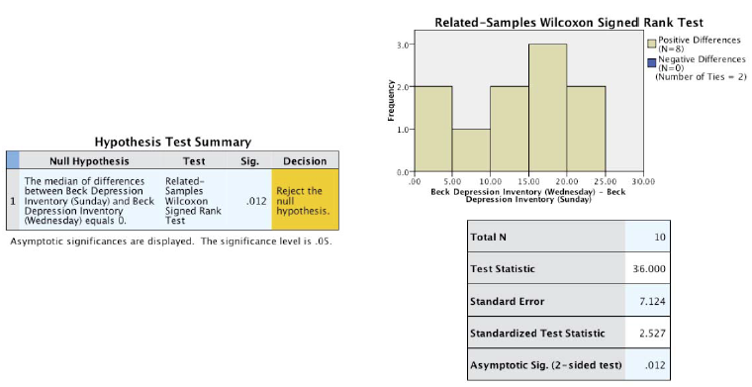
Output for the Ecstasy Group

Slide 21
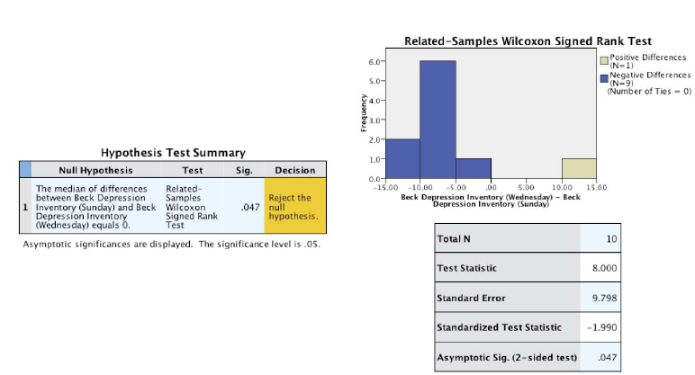
Output for the alcohol group

Slide 22
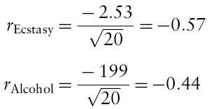
Calculating an Effect size
The effect size can be calculated in the same way as for the Mann–Whitney test.
In this case SPSS Output tells us that for the ecstasy group z is –2.53, and for the alcohol group is −1.99.
In both cases we had 20 observations
(although we only used 10 people and tested them twice, it is the number of observations, not the number of people, that is important here).
The effect size is therefore:

Slide 23
Reporting the results
Reporting Test-Statistic:
For ecstasy users depression levels were significantly higher on Wednesday (Mdn = 33.50) than on Sunday (Mdn = 17.50), T = 36, p = .012, r = .57. However, for alcohol users the opposite was true: depression levels were significantly lower on Wednesday (Mdn = 7.50) than on Sunday (Mdn = 16.0), T = 8, p = .047, r = −.44.
Reporting the values of z:
For ecstasy users, depression levels were significantly higher on Wednesday (Mdn = 33.50) than on Sunday (Mdn = 17.50), z = 2.53, p = .012, r = .57. However, for alcohol users the opposite was true: depression levels were significantly lower on Wednesday (Mdn = 7.50) than on Sunday (Mdn = 16.0), z = −1.99, p = .047, r = −.44.

Slide 24
Differences between several independent groups: the Kruskal–Wallis test
The Kruskal–Wallis test (Kruskal & Wallis, 1952;) is the non-parametric counterpart of the one-way independent ANOVA .
The theory is very similar to that of the Mann–Whitney (and Wilcoxon rank-sum) test:
It is based on ranked data.
The sum of ranks for each group is denoted by R_{i} (where i is used to denote the particular group).

Slide 25
Example
Does eating soya affect your sperm count?
Variables
Outcome: sperm (millions)
IV: Number of soya meals per week
No Soya meals
1 Soya meal
4 soya meals
7 soya meals
Participants
80 males (20 in each group)

Slide 26
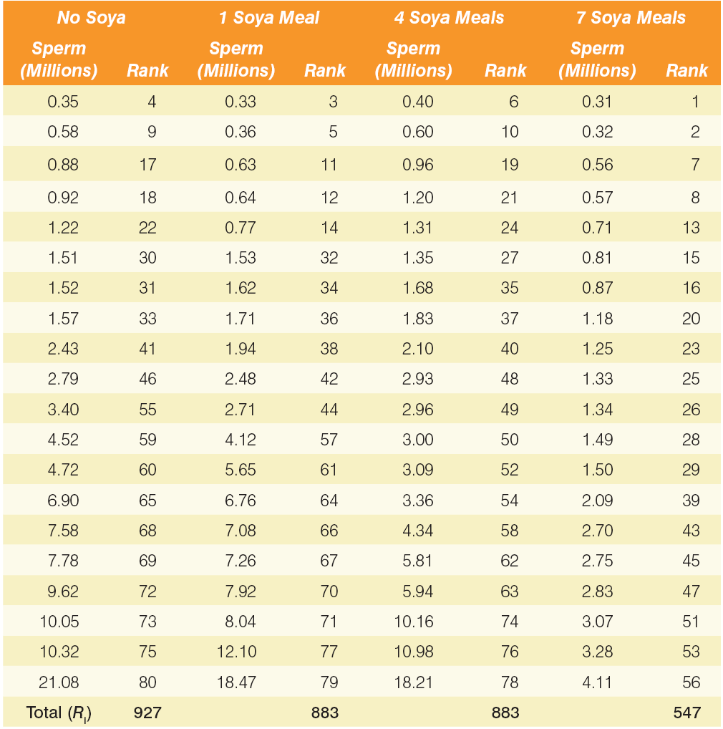
Data for the Soya Example with Ranks

Slide 27
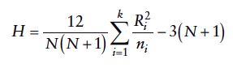
Kruskal-Wallis test Theory
Once the sum of ranks has been calculated for each group. The test statistic, H, is calculated as:
R_{i} is the sum of ranks for each group.
N is the total sample size.
n_{i} is the sample size of a particular group.

Slide 28
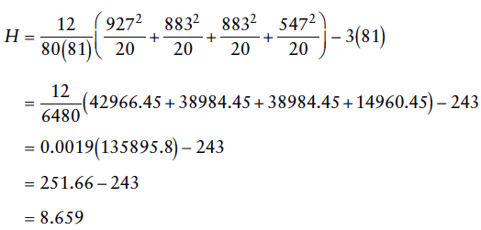
Kruskal-Wallis test Theory Continued

Slide 29
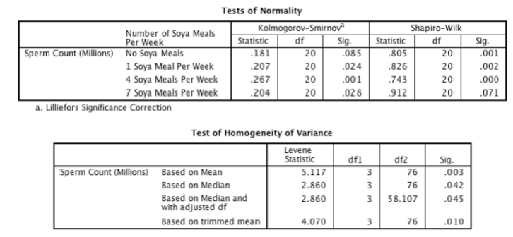
Provisional Analysis

Slide 30
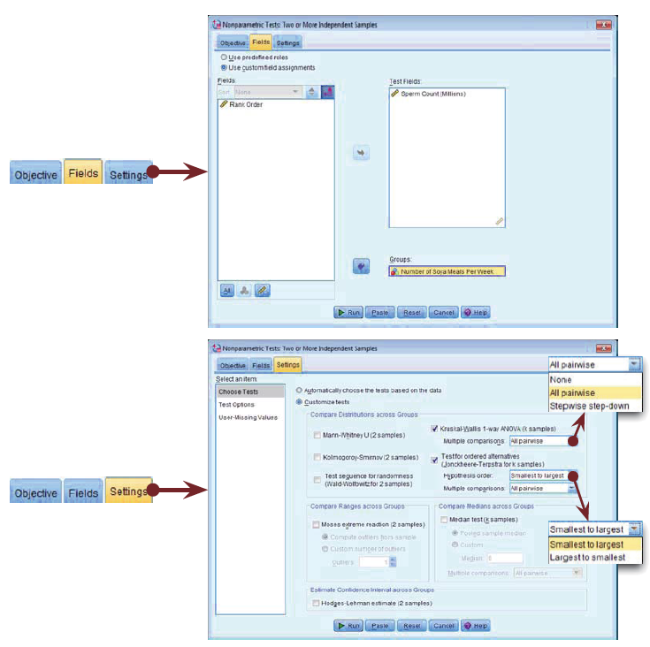
Running the Analysis

Slide 31
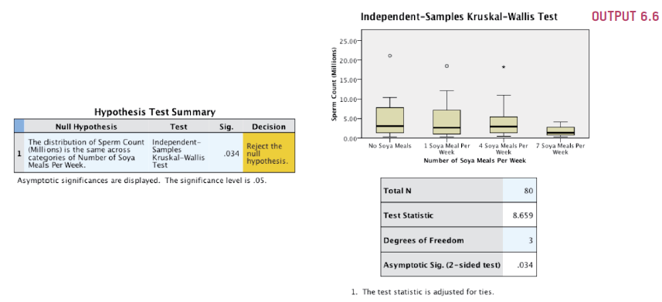
Output from the Kruskal–Wallis test

Slide 32
Follow-up Analysis
There are two ways to follow up a Kruskal-Wallis test in SPSS:
Pairwise Comparisons:
Test 1: one soya meal per week compared to no soya meals
Test 2: four soya meals per week compared to no soya meals
Test 3: seven soya meals per week compared to no soya meals
Adjust p values.
Stepped Procedure

Slide 33
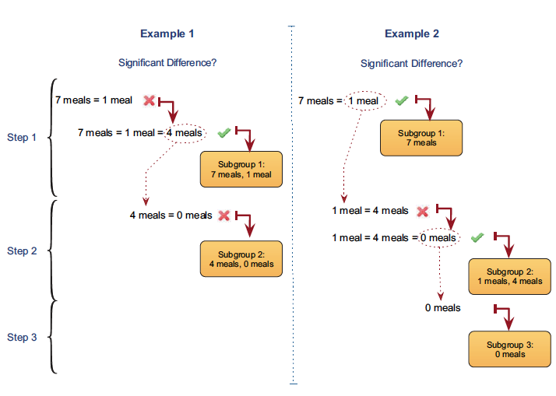
Stepped Procedure

Slide 34
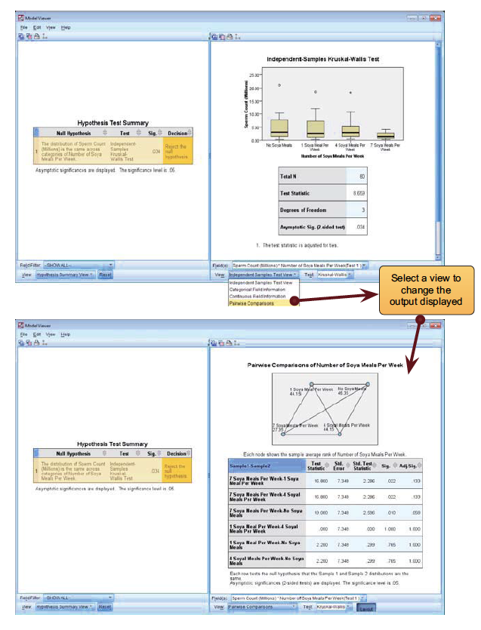
Follow-up Analysis

Slide 35
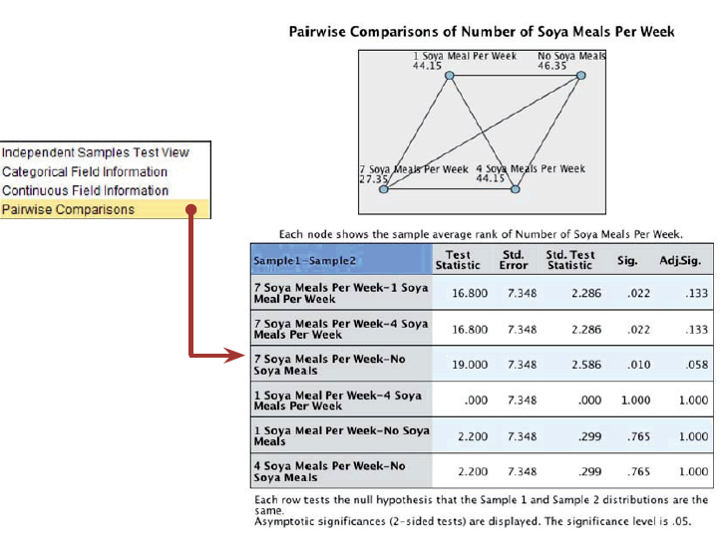

Slide 36
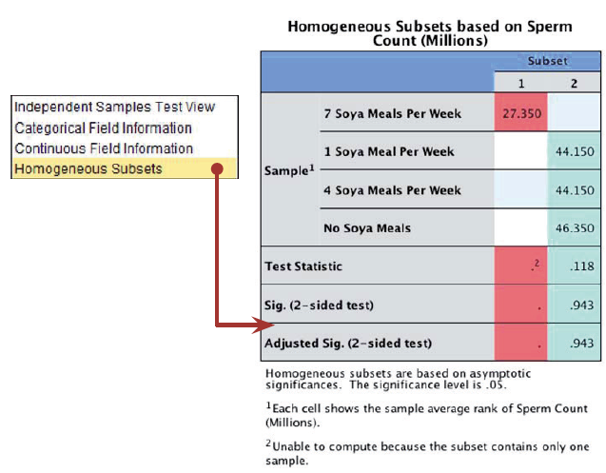

Slide 37
Testing for trends: the Jonckheere–Terpstra test
This statistic tests for an ordered pattern to the medians of the groups you’re comparing.
Essentially it does the same thing as the Kruskal–Wallis test but it incorporates information about whether the order of the groups is meaningful.
Use this test when you expect the groups you’re comparing to produce a meaningful order of medians.
In the current example we expect that the more soya a person eats, the more their sperm count will go down.

Slide 38
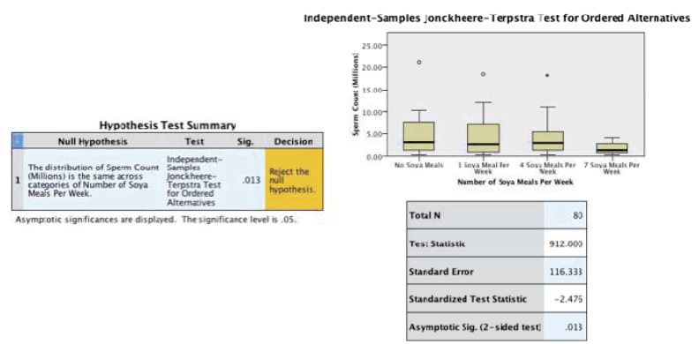
Output for Jonckheere-Terpstra Test

Slide 39
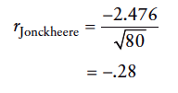
Calculating an Effect Size

Slide 40
Writing the Results
For the Kruskal–Wallis test, we need only report the test statistic (H), its degrees of freedom and its significance:
Sperm counts were significantly affected by eating soya meals, H(3) = 8.66, p = .034.

Slide 41
Writing the Results II
Follow-up tests:
Sperm counts were significantly affected by eating soya meals, H(3) = 8.66, p = .034. Pairwise comparisons with adjusted p values showed that there were no significant differences between sperm counts when people ate 7 soya meals per week compared to 4 meals (p = .133, r = .36), 1 meal (p = .133, r = .36), or no meals (p = .058, r = .41). There were also no differences in sperm counts between those eating 4 soya meals per week and those eating 1 meal (p = 1.00, r = .00) and no meals (p = 1.00, r = .05 ). Finally, there were no significant differences in sperm counts between those eating 1 soya meal per week and those eating none (p = 1.00, r = .05).
Sperm counts were significantly affected by eating soya meals, H(3)= 8.66, p = .034. Step-down follow-up analysis showed that if soya is eaten every day it significantly reduces sperm counts compared to eating none; however, eating soya less than every day has no significant effect on sperm counts, p = 943.

Slide 42
Writing the Results III
Or, we might want to report our trend:
Sperm counts were significantly affected by eating soya meals, H(3)= 8.66, p = .034. Jonckheere’s test revealed a significant trend in the data: as more soya was eaten, the median sperm count decreased, J = 912, z = −2.48, p = .013, r = −.28.

Slide 43
Differences between several related groups: Friedman’s ANOVA
Used for testing differences between conditions when:
There are more than two conditions
The same participants have been used in all conditions (each case contributes several scores to the data).
If you have violated some assumption of parametric tests then this test can be a useful way around the problem.

Slide 44
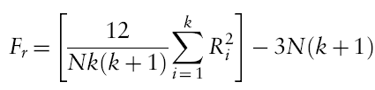
Theory of Friedman’s ANOVA
The theory for Friedman’s ANOVA is much the same as the other tests: it is based on ranked data.
Once the sum of ranks has been calculated for each group, the test statistic, F_{r}, is calculated as:

Slide 45
Example
Does the ‘andikins’ dert work?
Variables
Outcome: weight (Kg)
IV: Time since beginning the diet
Baseline
1 Month
2 Months
Participants
10 women

Slide 46
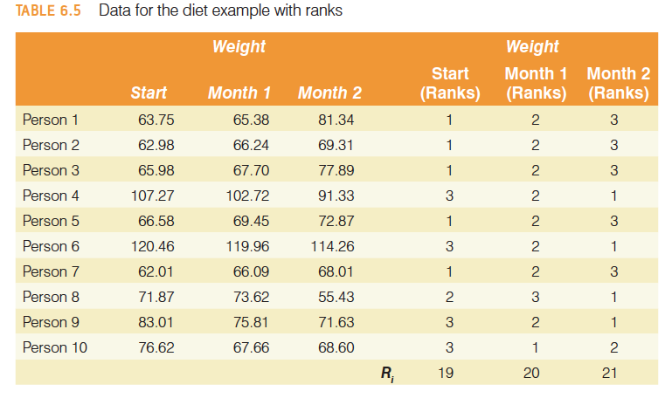

Slide 47
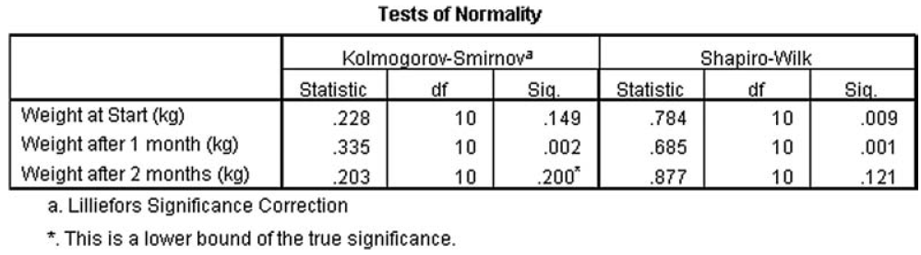
Provisional analysis

Slide 48
Running the Analysis

Slide 49
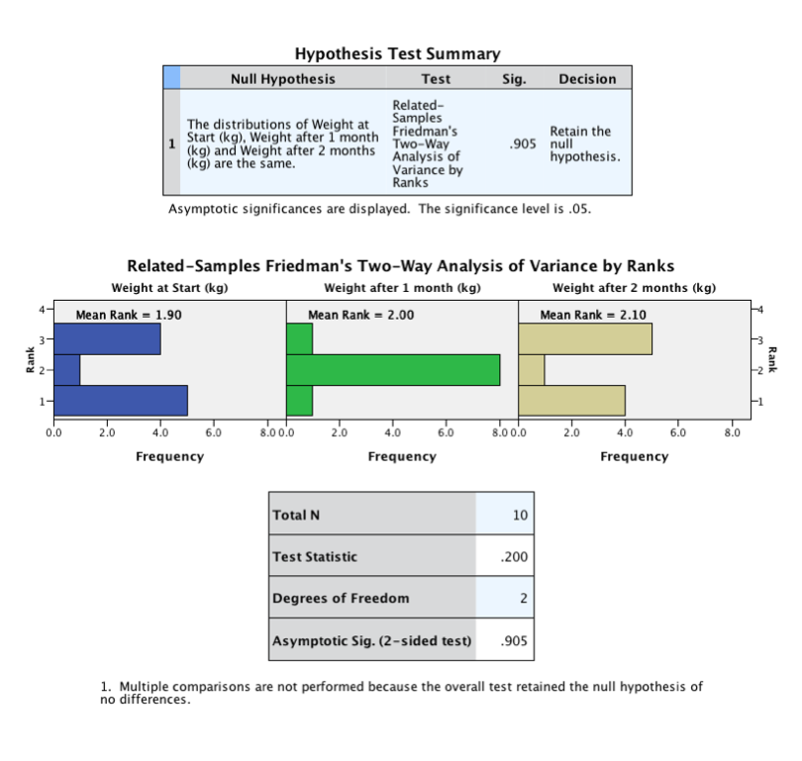
Output from Friedman’s ANOVA
There is no need to do any post hoc tests for this example because the main ANOVA was non-significant.

Slide 50
Writing and interpreting the results
For Friedman’s ANOVA we need only report the test statistic (χ²), its degrees of freedom and its significance:
The weight of participants did not significantly change over the two months of the diet, χ²(2) = 0.20, p = .91.

Slide 51
To sum up …
When data violate the assumptions of parametric tests we can sometimes find a nonparametric equivalent
Usually based on analysing the ranked data
Mann-Whitney/Wilcoxon rank-sum Test
Compares two independent groups of scores
Wilcoxon signed rank Test
Compares two dependent groups of scores
Kruskal-Wallis Test
Compares > 2 independent groups of scores
Friedman’s Test
Compares > 2 dependent groups of scores

